Slide 1
C286 - Neurophysics Final Project Unsupervised learning for rat behavior quantification
Aishwarya Dev
305515097

Slide 2
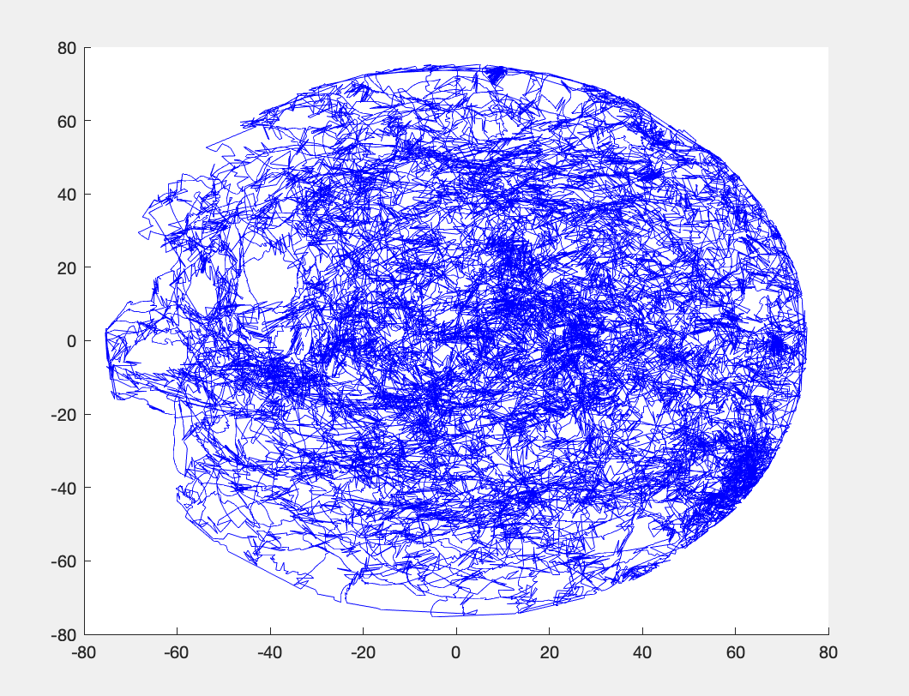
Data
Rat walks on an elevated table to get food.
12 trials done on different rats.
Position (x, y) of a rat across n observation time points.
Direction of a rat (in radians) across n observa-
tion time points.
Number of firing neurons per trial.
Spike time per neuron per experiment.
Fig. 1: Exp. no: 1, Position (y / x) across n = 68311 observation time points

Slide 3
Objective
Spike time position relative to rat’s position.
Probability of spikes as a function of direction (-180 to +180 degrees).
Clusters identifying neuron’s firing patterns.
Grouping neurons that fire together for a given stimuli.
Repeated across different trials and different neurons in each trial.

Slide 4
Implementation
Spike time position relative to rat’s position
Spikes were recorded before the movement began and after the movement stopped.
Rat was thinking something before the movement and after stopping.
Clip all entries that occurred before, after the actual recording.
Spike times do not match observation times.
Relative position at the time of the spike approximated to mean position for observation time immediately less than, greater than a given spike time.

Slide 5
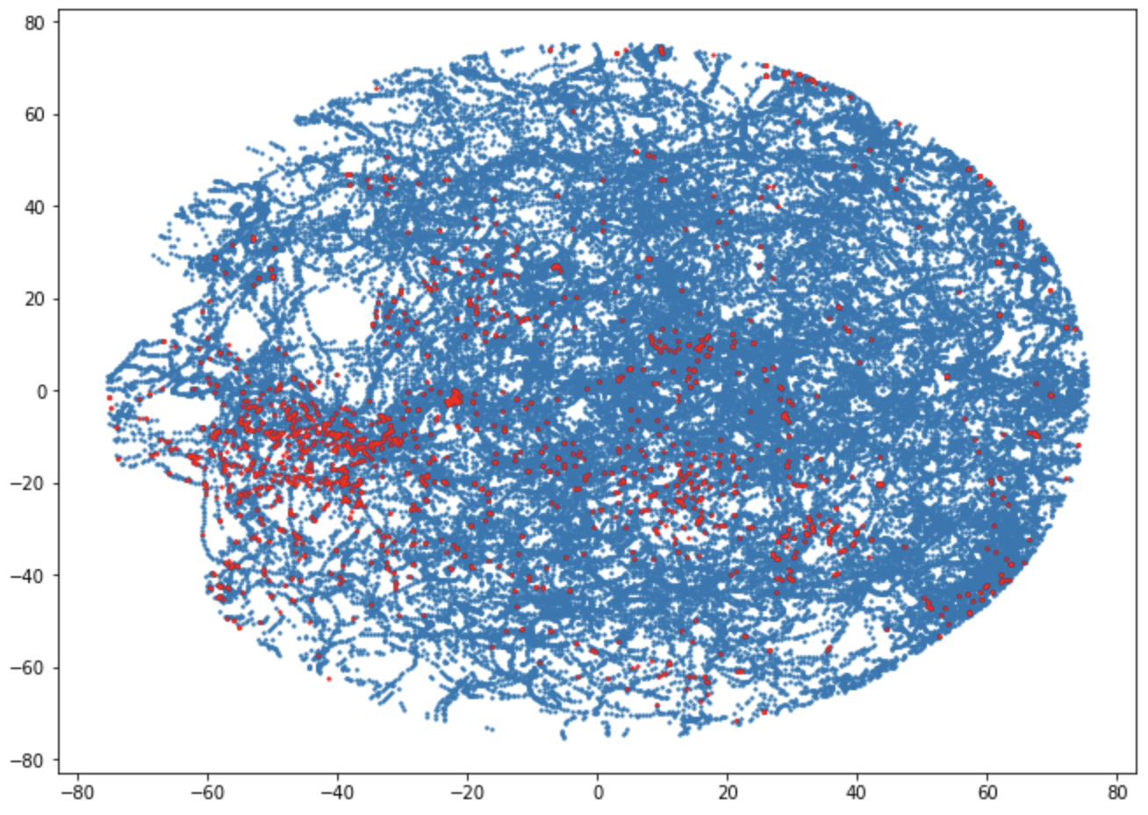
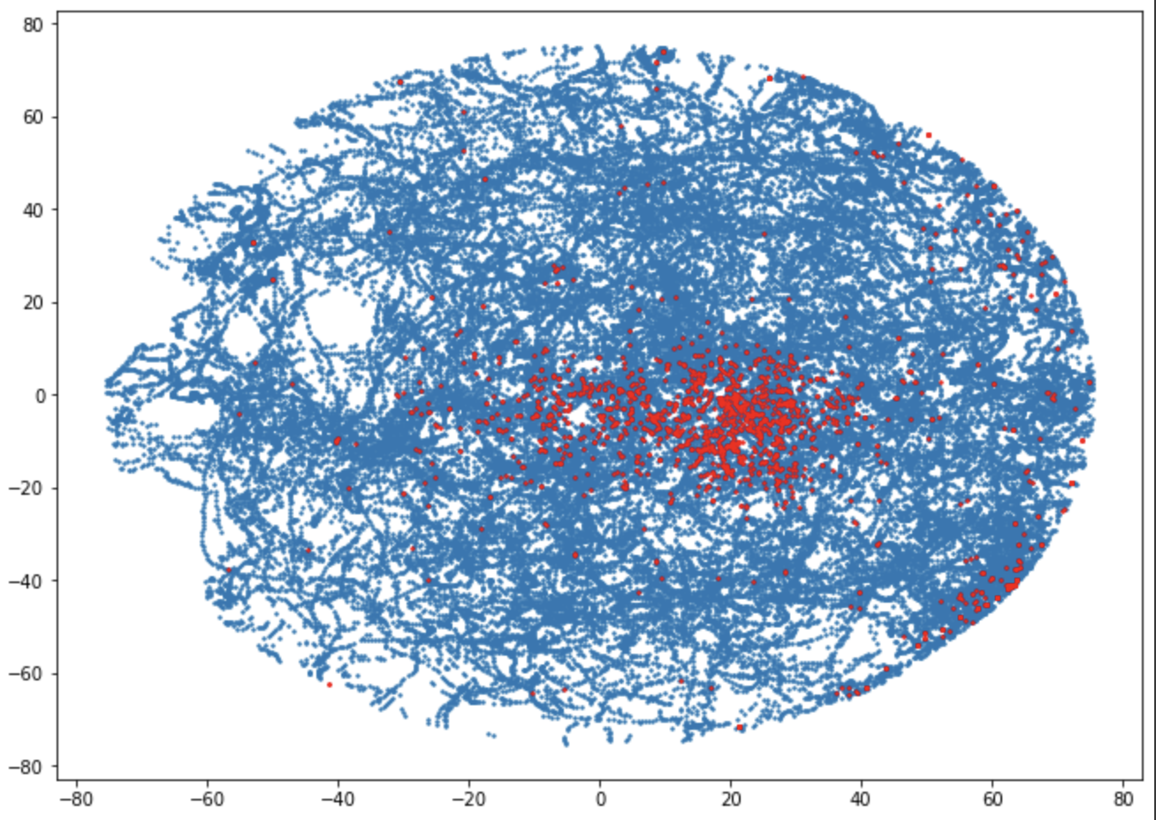
Spike time position relative to rat’s position
Fig. 2: Relative positions of the rat at the time of the spike (red) with respect to all position points (blue) for (a).experiment 0, neuron 0, (b). experiment 0, neuron 3

Slide 6
2. Probability of spikes as a function of direction
Clip all entries that occurred before, after the actual recording.
Spike times do not match observation times.
Relative direction at the time of the spike approximated to mean direction for observation time immediately less than, greater than a given spike time.
Gaussian Probability Density Function as line plot of direction (in degrees) vs relative frequency of spikes (rfs).
On an average, max firing occurred in the direction range -50 to 50 degrees.

Slide 7
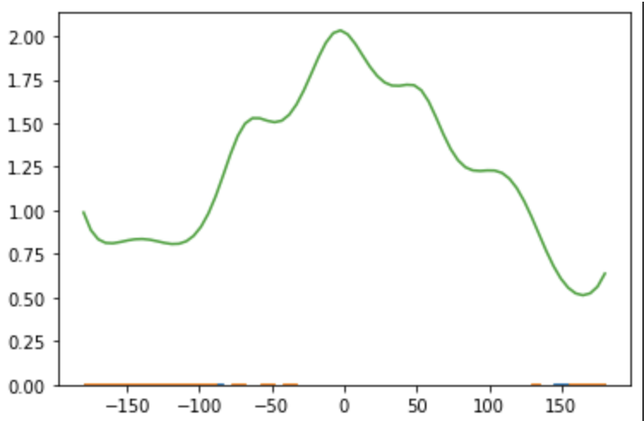
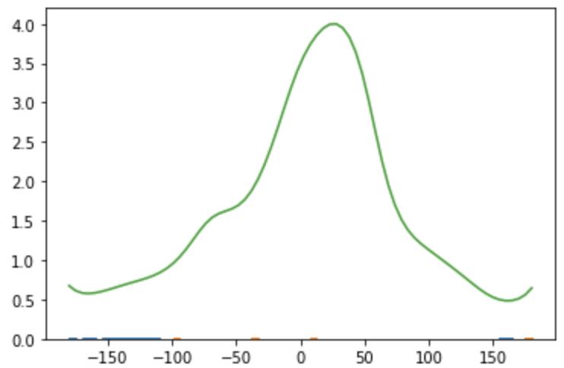
Probability of spikes as a function of direction
Fig. 3: Line plot of direction (in degrees) vs relative frequency of spikes (a).experiment 0, neuron 0, (b). experiment 0, neuron 3

Slide 8
3. Clusters identifying neuron’s firing patterns
Unsupervised learning for clustering.
K-means clustering using cluster size of 5.
Cluster plotting with different shapes and colors of markers to identify various clusters.
Cluster centroids marked with red stars.

Slide 9
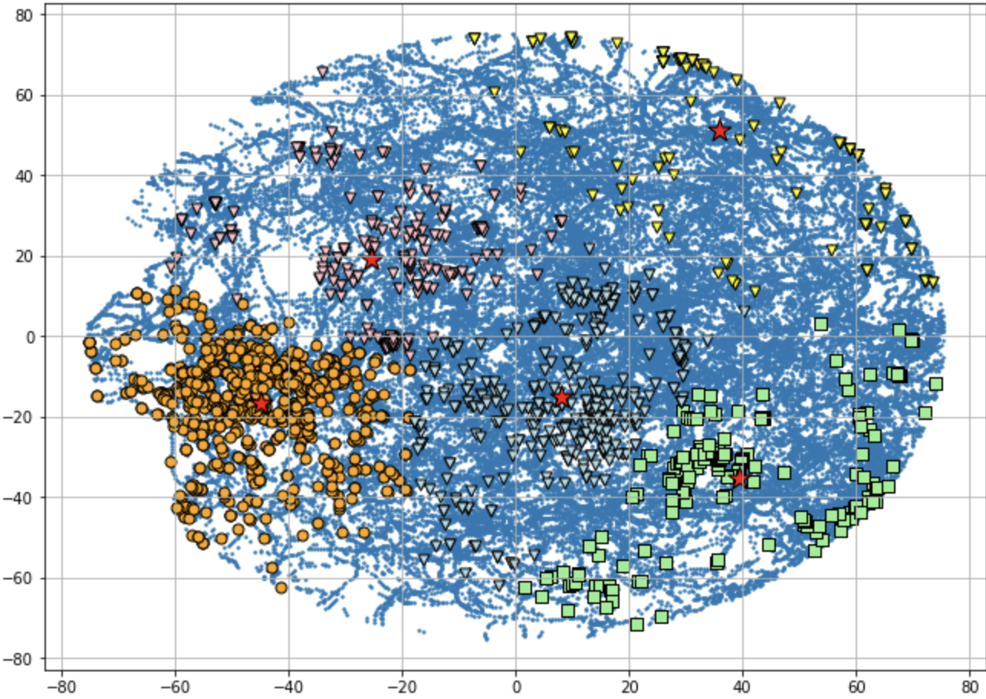
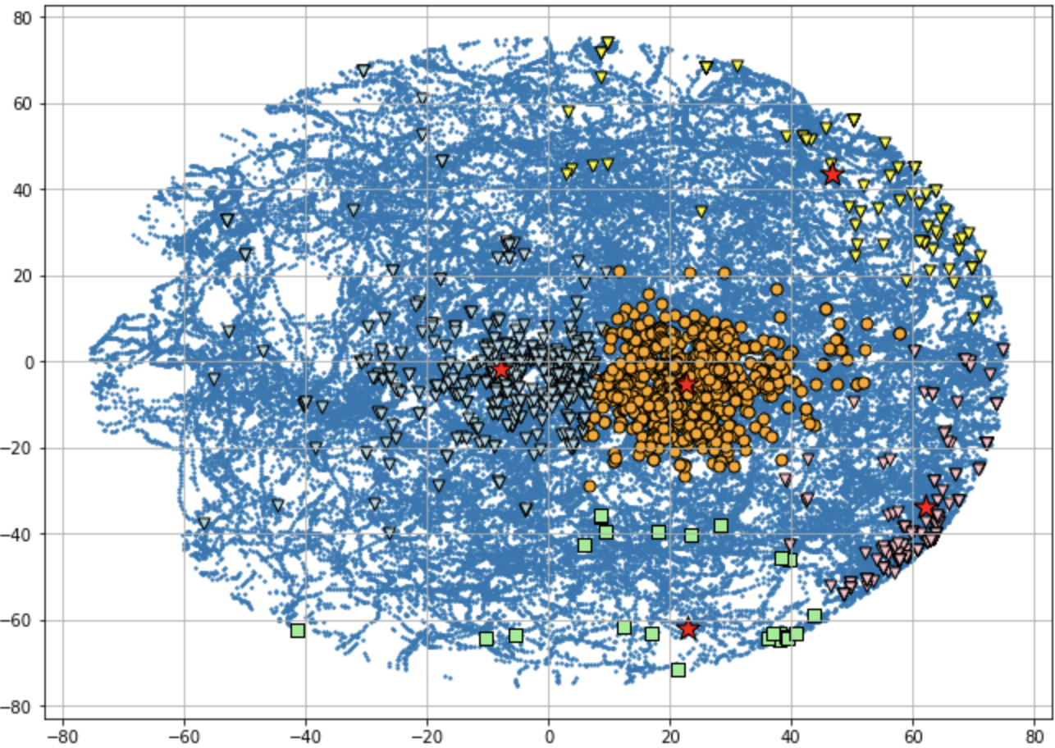
Clusters identifying neuron’s firing patterns
Fig. 4: Cluster Plots for (a).experiment 0, neuron 0, (b). experiment 0, neuron 3

Slide 10
4. Grouping neurons that fire together for a given stimuli
Compare the distance between the centroids of various clusters of different neurons.
Sort the values to determine cluster centroids closest to one another.
Pair the neurons with the closest centroids and form an adjacency matrix.

Slide 11
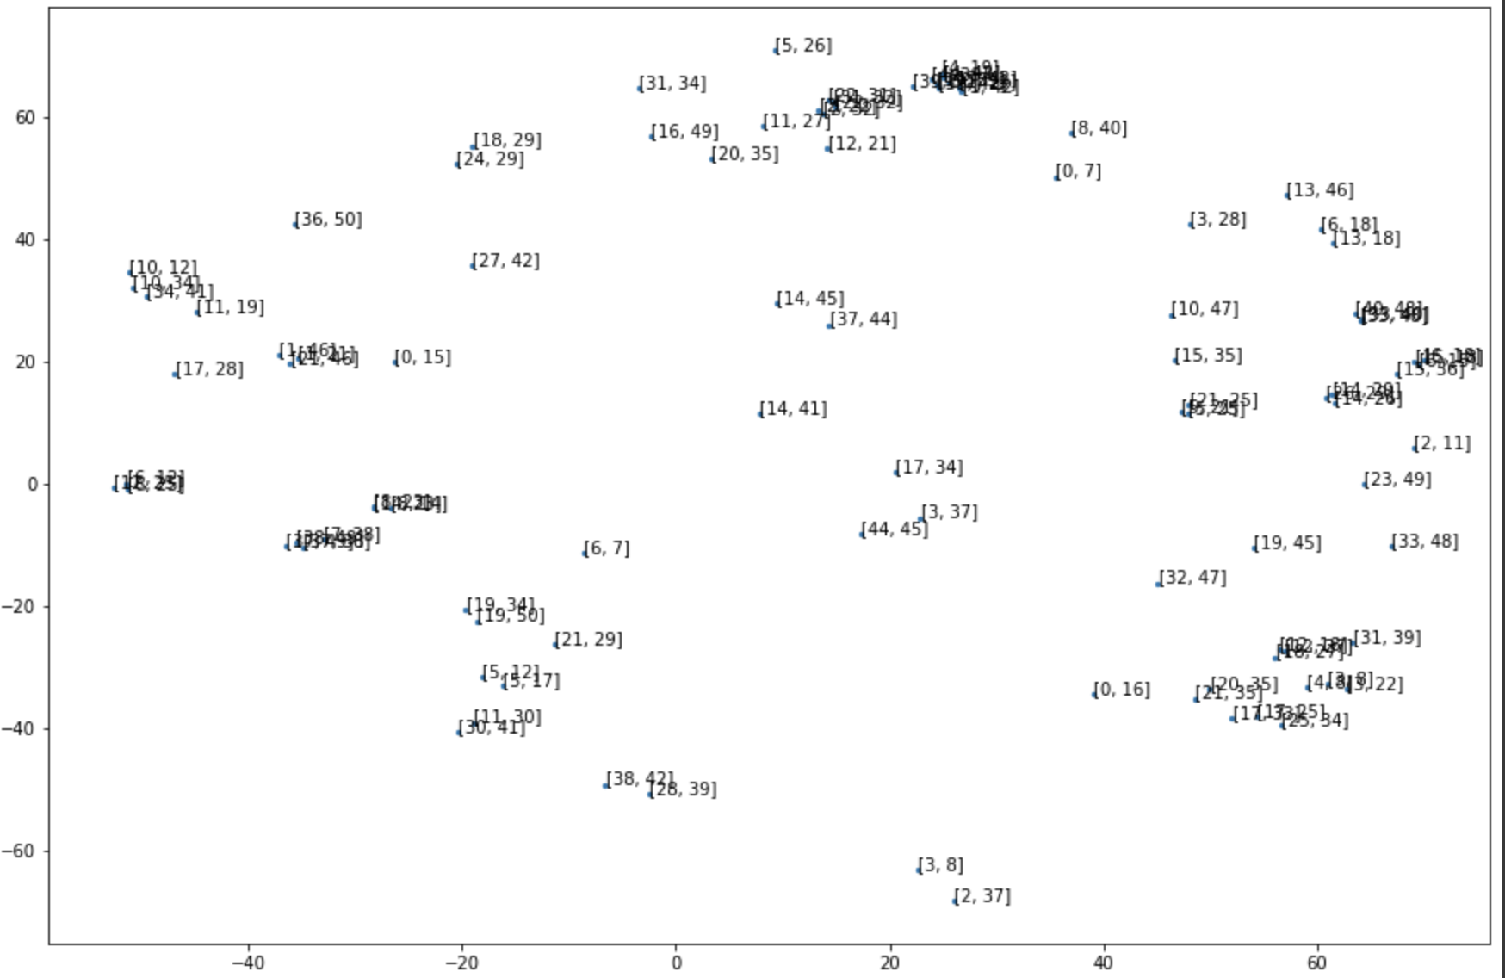
Grouping neurons that fire together for a given stimuli
Fig. 5: Pairwise grouping neurons that fire together relative to the position space for experiment 0, neuron 0

Slide 12
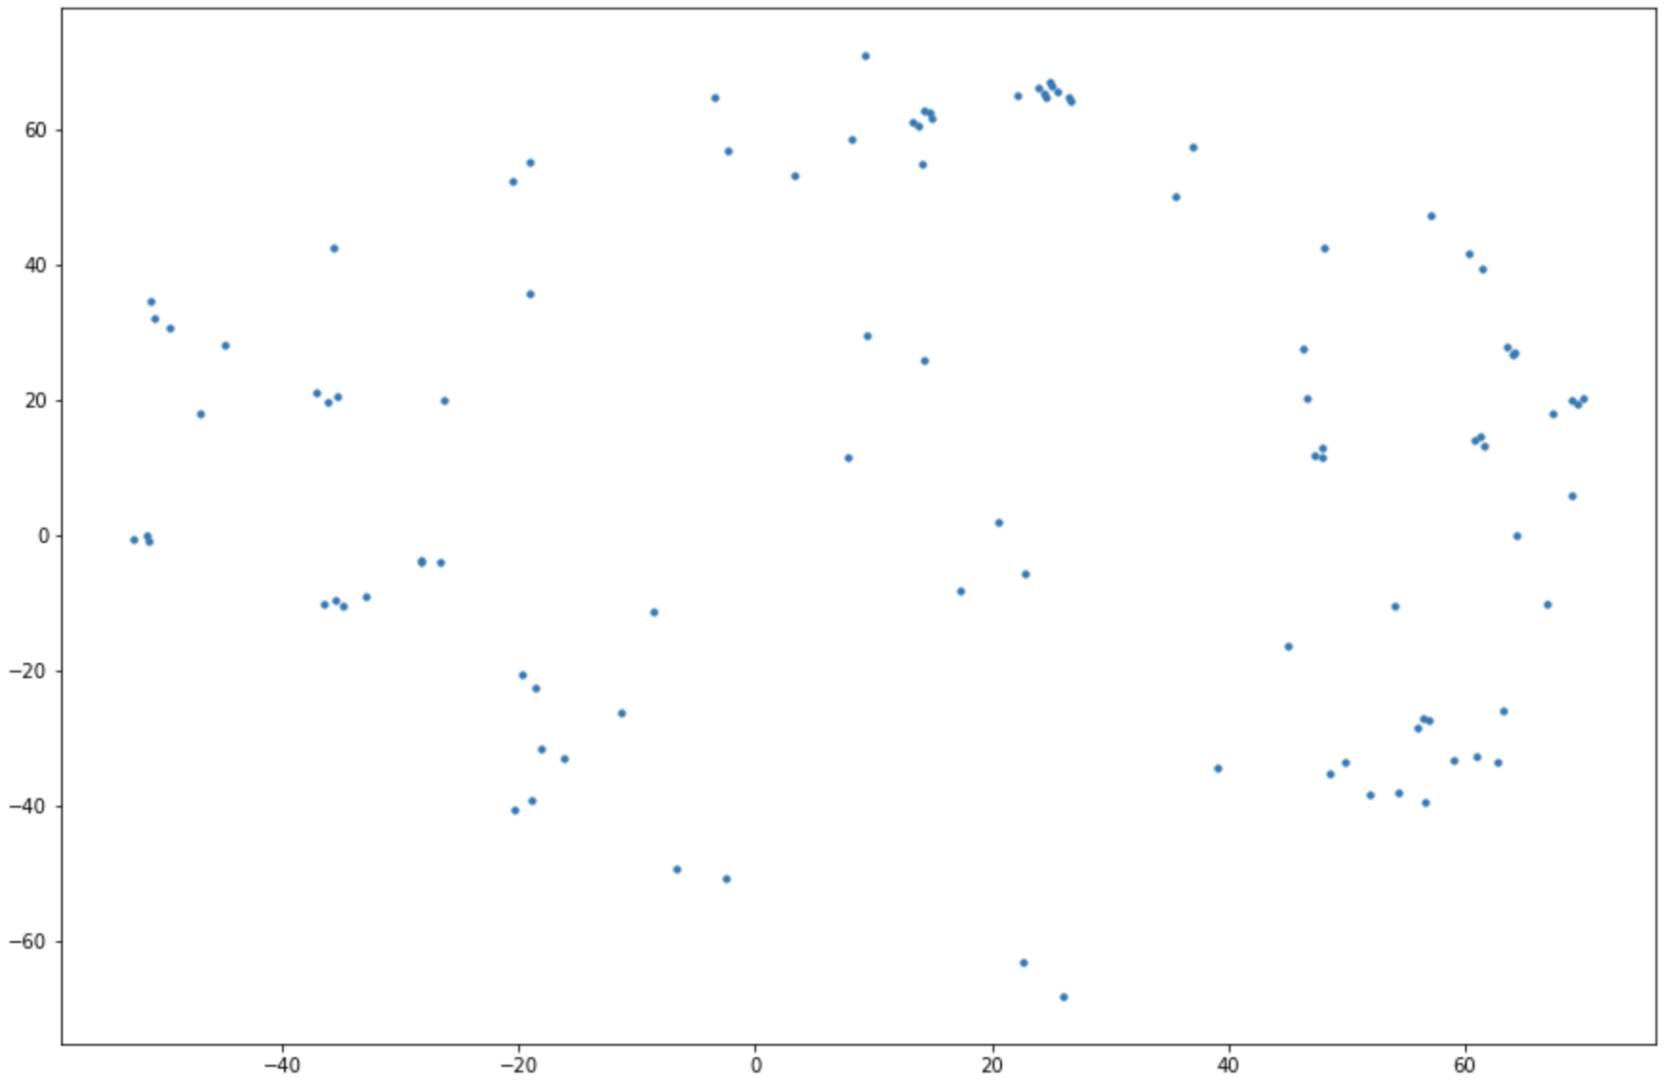
Grouping neurons that fire together for a given stimuli
Fig. 6: Simplified representation of Fig 5 without overlapping legends.

Slide 13
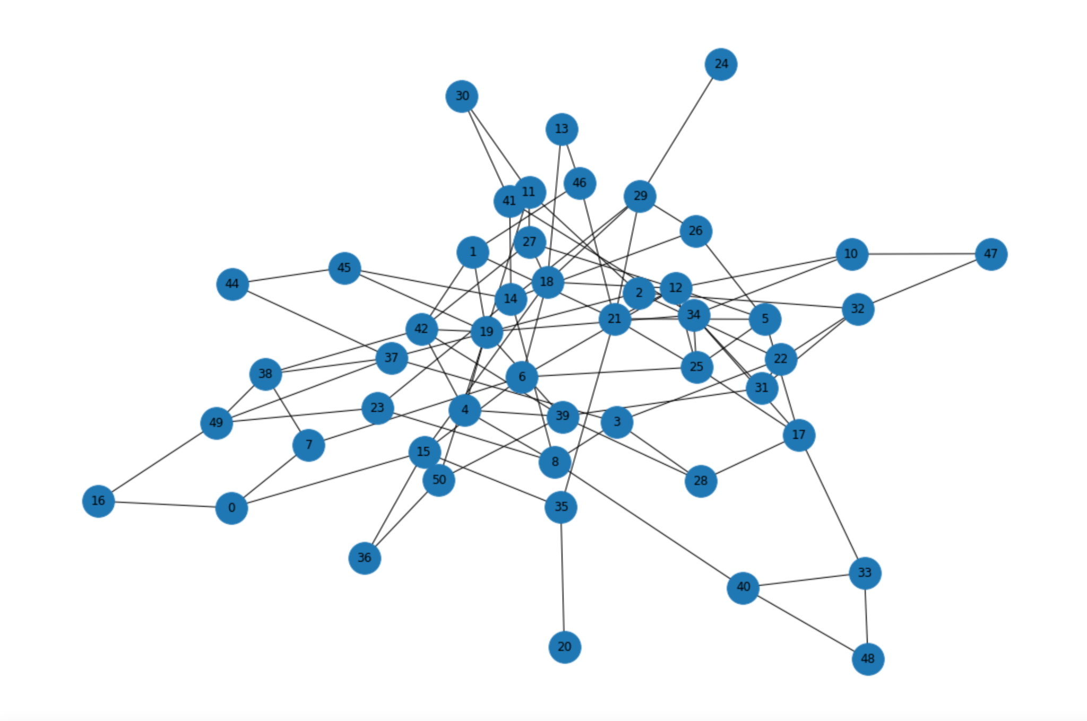
Grouping neurons that fire together for a given stimuli
Fig. 7: Neurons firing together connected by edges. Nearer connections indicate higher level of similar behavior.

Slide 14
Thank you

